Slide 1
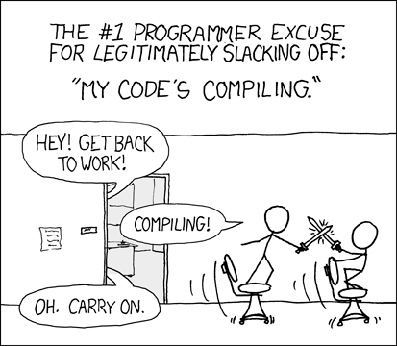
Programming Club Agenda
DATE HERE
GOAL: finish up coding strings and work on our very own Mad Libs!

Slide 2

Welcome to the Programming Club!
Take out your laptops and log on to your account at http://koding.io.
Now it’s lunch time! At 11:05, we’ll start coding!

Slide 3
Mad Libs
Preparation: Creating and Running Your Programs
To create a new file, type touch madlibs.py in the console.
  You can use other names for your file. Just replace madlibs with whatever name you want.
Double-click the file to open it. You can drag the tab with the file in it to the upper part of your workspace.
To run your program, type python madlibs.py in the console.
  Remember, if you had a different name for your file, replace madlibs with the file name you chose earlier.

Slide 4
Mad Libs
(Review) Part 1: Strings and Integers
A string is a variable that holds text.
  For example:
    “Tech Guy”
    “Welcome!”
  They can be used to tell the user of the program what to do or to hold information such as names, text messages, etc.
An integer is a variable that holds a number. It can be zero or a negative/positive number.
  For example:
    150 dollars
    5th blank in Mad Libs
    -12, 0, 3, 42, 159, 314, 1337
Now what happens when you combine two strings? More on that next!

Slide 5
Mad Libs
(Review) Part 2: String Concatenation
Concatenating a string means to add one string to another string.
In Python, string concatenation is easy!
If you wanted to say “My friend has a cool refrigerator”, you could use the following combinations:
  person = “friend”
  “My “ + person + “ has a cool refrigerator”
  thing = “refrigerator”
  “My friend has a cool “ + thing
  adjective = “cool”
  “My friend has a “ + adjective + “ refrigerator”
You could even go all in if you wanted to… (%s means a string)
  print(“My %s has a %s %s” % (person, adjective, thing))

Slide 6
Mad Libs
Part 3: Getting Input from the User
What if you wanted to ask the user of the program for some text?
To store the user input, you’ll need to create a variable to store it in and a prompt.
  For example, if you wanted to get the name of an object, you’ll use raw_input and a prompt in quotes inside the parentheses.
  You need to press ENTER when you’re done writing your input.
object = raw_input(“Please enter an object: ”)
print(“My dog is wearing a ” + object + “.”)
  If the user entered “watch” as the input, the output would be:
“My dog is wearing a watch.”

Slide 7
Mad Libs
Challenge #1: Create your OWN Mad Libs!
Using the methods and tools you’ve just learned, create your OWN Mad Libs game.
From what you’ve just learned, please make sure to use the following techniques in your program:
  Store nouns, adjectives, or other parts of speech using the raw_input method (remember to store it in a variable).
    For example, a_noun = raw_input(“Please enter a noun: “)
  Print sentences to the console using your variables (you don’t need to use all of them in one sentence, but use all of them in both).
    To print “Your output here” to the console, use print(“Your output here”) on one line.
Good luck! We’ll be happy to help!

Slide 8

Thank you for attending :)
Our next meeting is on DATE. Until then, have a great week and holiday break! Stay warm!
Special thanks to:
  [Names here]
  and you for your continued support which makes the Programming Club possible!

